Slide 1
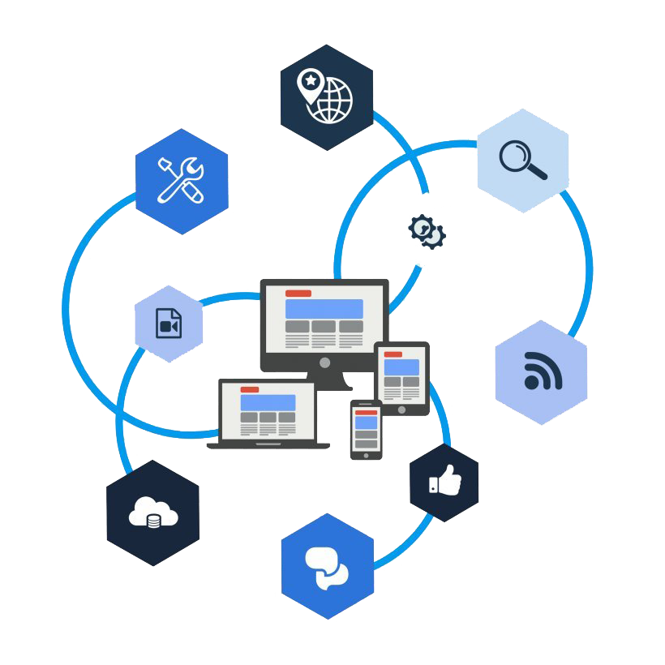
Gratitude++ Requirements Presentation
Web Application

Slide 2
Agenda
Introduction
Requirements
Notable Components
Technology Stack
Risks

Slide 3
Introduction
The team has decided to create a web application journal that helps focus positive events and feelings towards a sense of gratitude for the user. Taking this into consideration as well as this is a computer science project, we have named the project Gratitude++.

Slide 4
Requirements
Sign in Form
User Account Registration
Page Navigation
Journal Entry Component
Word Cloud Component
6. Journal History Component
7. Community Page Component
8. Admin Page Component
9. Article Display Component
10. Mobile Site Component

Slide 5
Notable Components

Slide 6

Word Cloud Component

Slide 7
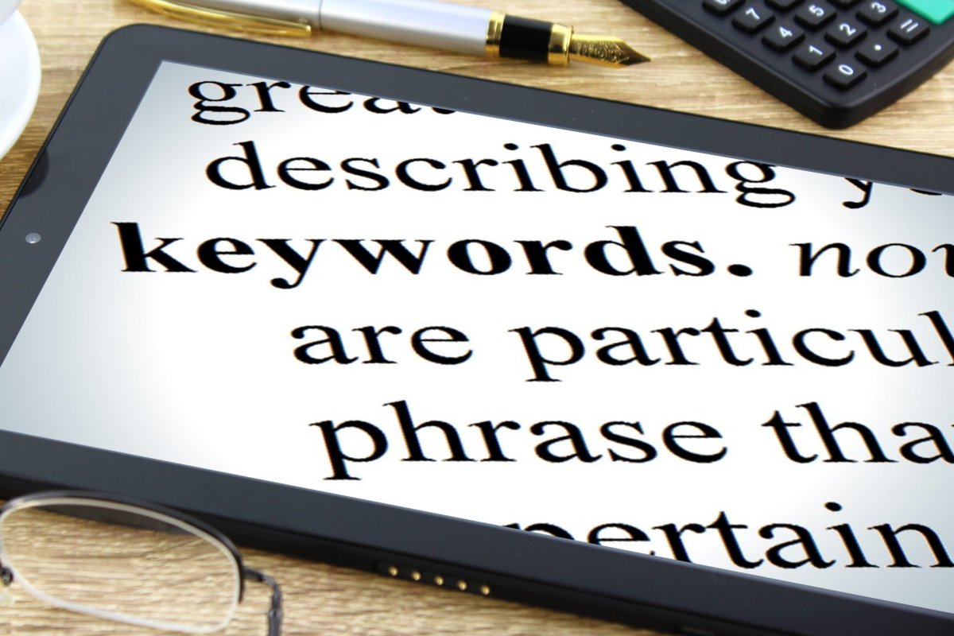
There will be a Word Cloud component that visually represents the key words taken from all the user’s headlines that have been posted.
The word cloud will be of varying sizes and colors in relation to the number of occurrences of key words.
The word cloud should utilize dynamic visual tools such as on-hover distinctions
This Photo by Unknown author is licensed under CC BY-SA.

Slide 8

The keywords should individually be clickable
Clicking a keyword will navigate to pop up window that will display all posts made by that user that contain that keyword
A list of article headlines and date stamps and content will be listed in order from most recent.
Clicking a headline will populate the Article Display Component

Slide 9
II. Mobile First Design

Slide 10

Utilizing React Libraries and Node.js the Web application will be designed with a Mobile first approach.
While this falls just short of creating a true mobile app it will still make the project user friendly for mobile users

Slide 11
III. Building A Better Community

Slide 12
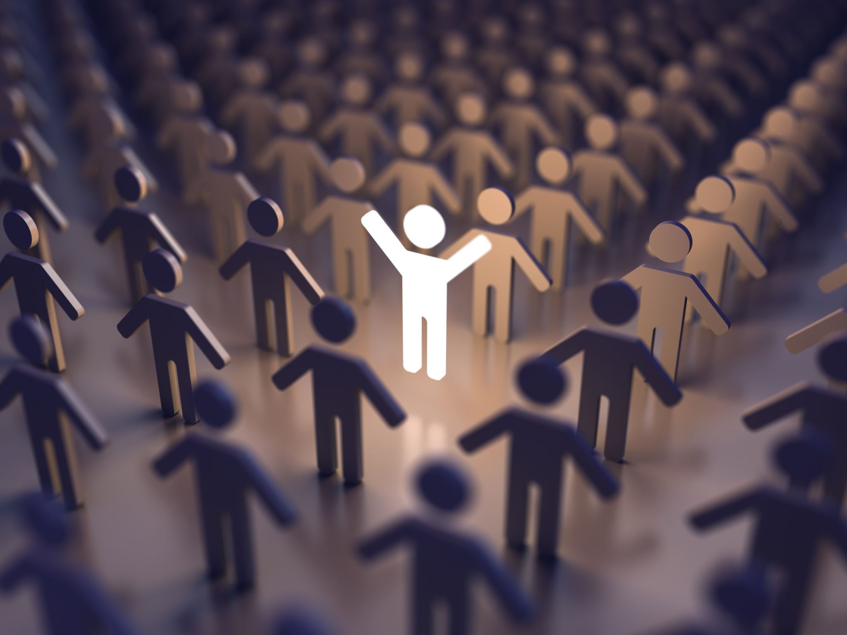
There will be a community component to allow users to share entries to others.
This page will allow users to share their expression with others on the site.
The goal of the community page is to allow freedom to users and create a community of people who are focused on positive and feelings towards others.

Slide 13
Risks
All requirements on this project carry some form of risks, but the ones that are seen as the most troublesome are the ones that require usage of the server and database components. While the group has experience with web design and the languages being used, Node.js and Firebase that will be used for the project will be the biggest issues facing the team.

Slide 14
Created By
Benjamin Seifried and Joel Scott

